Slide 1
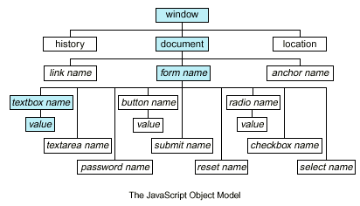
Document Object Model (DOM)
Traverse / Modify the DOM Tree

Slide 2
What is DOM?
What is Document Object Model (DOM)?
HTML documents in the browser are stored as "DOM tree"
Consists of elements with child elements
Elements have properties (attribute + value) and events
The DOM API allows search / modify the DOM tree
let menu = document.getElementById('menu');
menu.style.display = 'none';
menu.appendChild(document.createElement('hr'));

Slide 3
Selecting HTML Elements from DOM
Select a single element → returns HTMLElement
Select a collection of elements → returns a collection
let header = document.getElementById('header');
let nav = document.querySelector('#main-nav');
let root = document.documentElement;
let inputs = document.getElementsByTagName('li');
let towns = document.getElementsByName('towns[]');
let header = document.querySelectorAll('#nav li');
let allLinks = document.links;

Slide 4
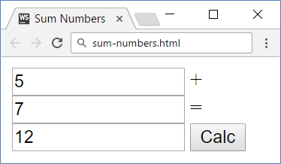
Problem: Sum Numbers
Write a JS function to sum two numbers (fill the missing code)
<input type="text" id="num1" /> +
<input type="text" id="num2" /> =
<input type="text" id="sum" readonly="readonly" />
<input type="button" value="Calc" onclick="calc()" />
<script>
function calc() {
// TODO: sum = num1 + num2
}
</script>

Slide 5
Solution: Sum Numbers
function calc() {
let num1 = document.getElementById('num1').value;
let num2 = document.getElementById('num2').value;
let sum = Number(num1) + Number(num2);
document.getElementById('sum').value = sum;
}
Check your solution here: https://judge.softuni.bg/Contests/328

Slide 6

DOM API: Element Properties
<div id="first" class="big">First <b>DIV</b></div>
let div = document.getElementById('first');
console.log(div.id); // first
console.log(div.tagName); // DIV
console.log(div.className); // big
console.log(div.textContent); // First DIV
console.log(div.innerHTML); // First <b>DIV</b>
console.log(div.outerHTML); // <div id="first" class="big">First <b>DIV</b></div>

Slide 7
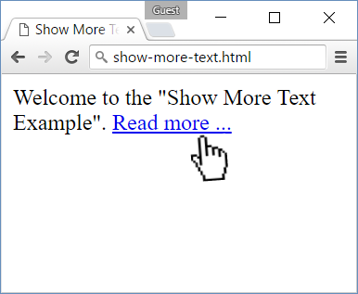
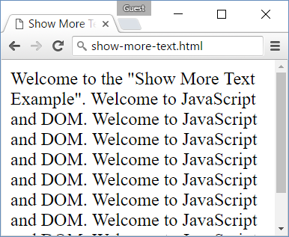
Problem: Show More Text
A HTML page holds a short text + link "Read more …"
Clicking on the link shows more text and hides the link

Slide 8
Problem: Show More Text – HTML
Welcome to the "Show More Text Example".
<a href="#" id="more" onclick= "showText()">Read more …</a>
<span id="text" style= "display:none">Welcome to …</span>
<script>
function showText() {
// TODO
}
</script>
See the DOM tree here: http://software.hixie.ch/utilities/js/live-dom-viewer/?saved=4275

Slide 9
Solution: Show More Text
Welcome to the "Show More Text Example". <a href="#" id="more" onclick="showText()">Read more …</a>
<span id="text" style="display:none">Welcome to …</span>
<script>
function showText() {
document.getElementById('text')
.style.display = 'inline';
document.getElementById('more')
.style.display = 'none';
}
</script>
Check your solution here: https://judge.softuni.bg/Contests/328

Slide 10
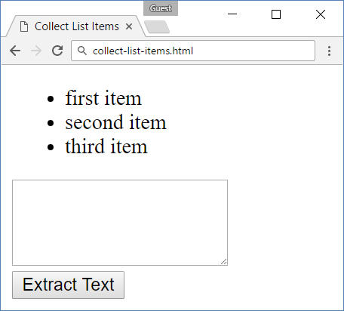
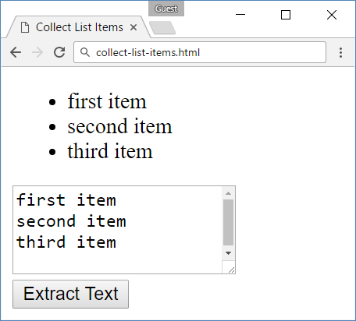
Problem: Collect List Items
Collect the list items from given HTML list and append their text to given text area

Slide 11
Problem: Collect List Items – HTML
<ul id="items">
<li>first item</li>
<li>second item</li>
<li>third item</li>
</ul>
<textarea id="result"> </textarea>
<br>
<button onclick="extractText()"> Extract Text</button>

Slide 12
Solution: Collect List Items
function extractText() {
let itemNodes =
document.querySelectorAll("ul#items li");
let textarea =
document.querySelector("#result");
for (let node of itemNodes) {
textarea.value += node.textContent + "\n";
}
}
Check your solution here: https://judge.softuni.bg/Contests/328

Slide 13
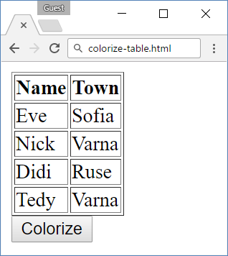
Problem: Colorize Table Rows
A HTML page holds a table with rows
On button click, colorize in color "teal" all even rows
<table border="1">
<tr><th>Name</th><th>Town</th></tr>
<tr><td>Eve</td><td>Sofia</td></tr>
<tr><td>Nick</td><td>Varna</td></tr>
<tr><td>Didi</td><td>Ruse</td></tr>
<tr><td>Tedy</td><td>Varna</td></tr>
</table>
<button onclick="colorizeRows()">Colorize</button>

Slide 14
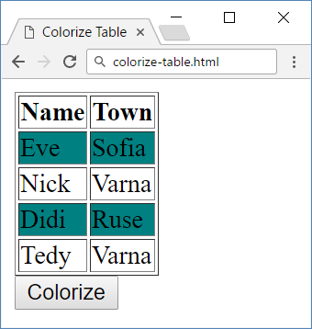
Solution: Colorize Table Rows
function colorizeRows() {
let rows = document.
querySelectorAll("table tr");
let index = 0;
for (let row of rows) {
index++;
if (index % 2 == 0)
row.style.background = "teal";
}
}
Check your solution here: https://judge.softuni.bg/Contests/328

Slide 15
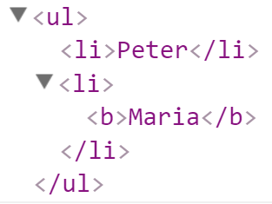
Creating New DOM Elements
let list = document.createElement("ul");
let liPeter = document.createElement("li");
liPeter.textContent = "Peter";
list.appendChild(liPeter);
let liMaria = document.createElement("li");
liMaria.innerHTML = "<b>Maria</b>";
list.appendChild(liMaria);
document.body.appendChild(list);

Slide 16
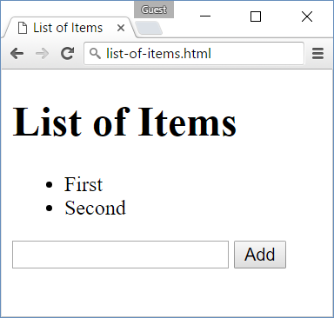
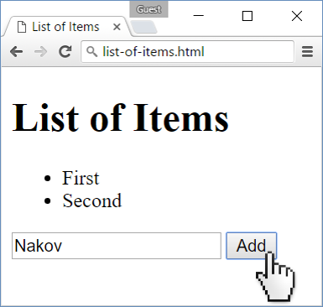
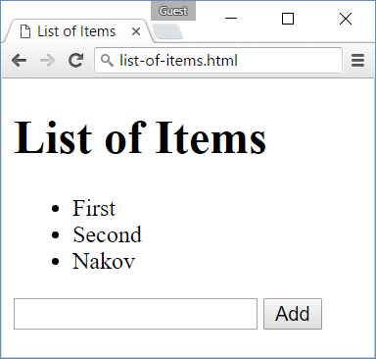
Problem: List of Items
Create a HTML page holding a list of items + text box + button for adding more items to the list
Write a JS function to append the specified text to the list

Slide 17
Problem: List of Items – HTML
<h1>List of Items</h1>
<ul id="items"><li>First</li><li>Second</li></ul>
<input type="text" id="newText" />
<input type="button" value="Add" onclick="addItem()">
<script>
function addItem() {
// TODO: add new item to the list
}
</script>

Slide 18
Solution: List of Items
function addItem() {
let text =
document.getElementById('newText').value;
let li = document.createElement("li");
li.appendChild(document.createTextNode(text));
document.getElementById("items").appendChild(li);
document.getElementById('newText').value = '';
}
Check your solution here: https://judge.softuni.bg/Contests/328

Slide 19
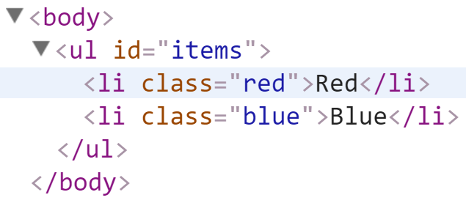
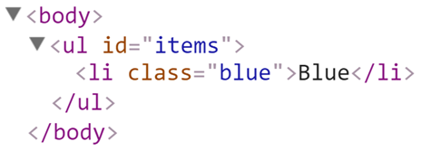
Deleting DOM Elements
<ul id="items">
<li class="red">Red</li>
<li class="blue">Blue</li>
</ul>
let redElements =
document.querySelectorAll("#items li.red");
redElements.forEach(li => {
li.parentNode.removeChild(li);
});

Slide 20
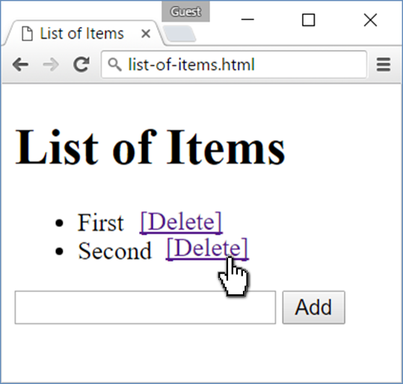
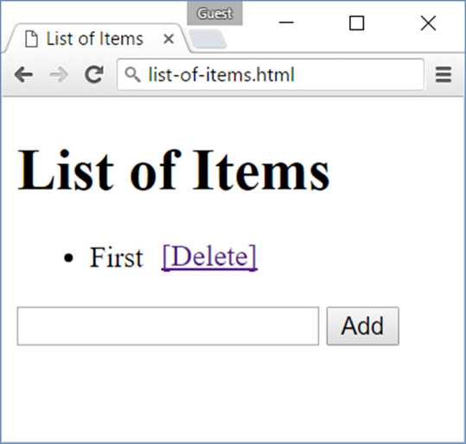
Problem: Add / Delete Items
Extend the previous problem
Implement [Delete] action as link after each list item

Slide 21
Problem: Add / Delete Items – HTML
<h1>List of Items</h1>
<ul id="items"></ul>
<input type="text" id="newText" />
<input type="button" value="Add" onclick="addItem()">
<script>
function addItem() { ...
function deleteItem() { ... }
}
</script>

Slide 22
Solution: Add / Delete Items
function addItem() {
let text = document.getElementById('newText').value;
let li = document.createElement("li");
li.appendChild(document.createTextNode(text + " "));
let span = document.createElement('span');
span.innerHTML = "<a href='#'>[Delete]</a>";
span.firstChild.addEventListener('click', deleteItem);
li.appendChild(span);
document.getElementById("items").appendChild(li);
document.getElementById('newText').value = '';

Slide 23
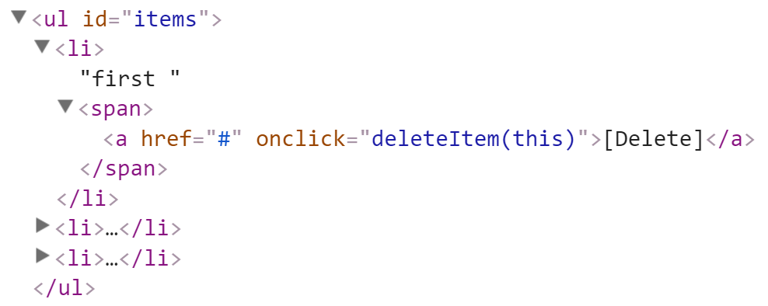
Solution: Add / Delete Items (2)
function deleteItem() {
let li = this.parentNode.parentNode;
let ul = li.parentNode;
ul.removeChild(li);
}
}
this.parentNode.parentNode == li
this.parentNode == span
this holds the clicked hyperlink
Check your solution here: https://judge.softuni.bg/Contests/328

Slide 24
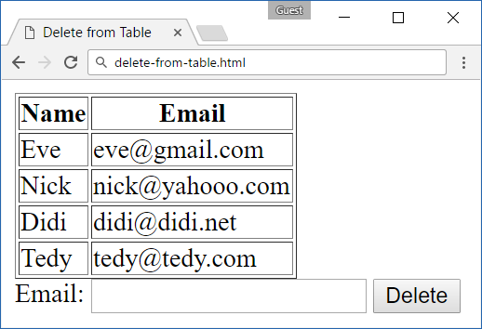
Problem: Delete from Table
<table border="1" id="customers">
<tr><th>Name</th><th>Email</th></tr>
<tr><td>Eve</td><td>eve@gmail.com</td></tr>
<tr><td>Nick</td><td>nick@yahooo.com</td></tr>
<tr><td>Didi</td><td>didi@didi.net</td></tr>
<tr><td>Tedy</td><td>tedy@tedy.com</td></tr>
</table>
Email: <input type="text" name="email" />
<button onclick="deleteByEmail()">Delete</button>
<div id="result" />

Slide 25
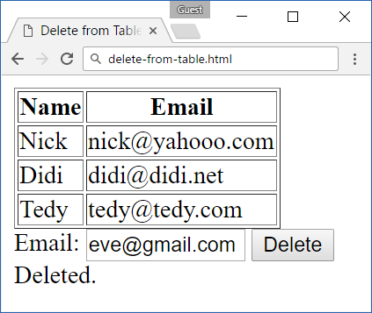
Solution: Delete from Table
function deleteByEmail() {
let email = document.getElementsByName("email")[0].value;
let secondColumn = document.querySelectorAll(
"#customers tr td:nth-child(2)");
for (let td of secondColumn)
if (td.textContent == email) {
let row = td.parentNode;
row.parentNode.removeChild(row);
document.getElementById('result').
textContent = "Deleted.";
return;
}
document.getElementById('result').textContent = "Not found.";
}
Check your solution here: https://judge.softuni.bg/Contests/328

Slide 26


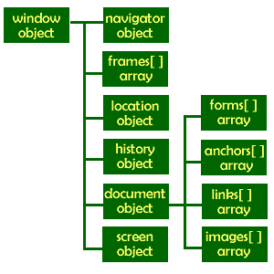
Browser Object Model (BOM)
The Built-In Browser Objects

Slide 27
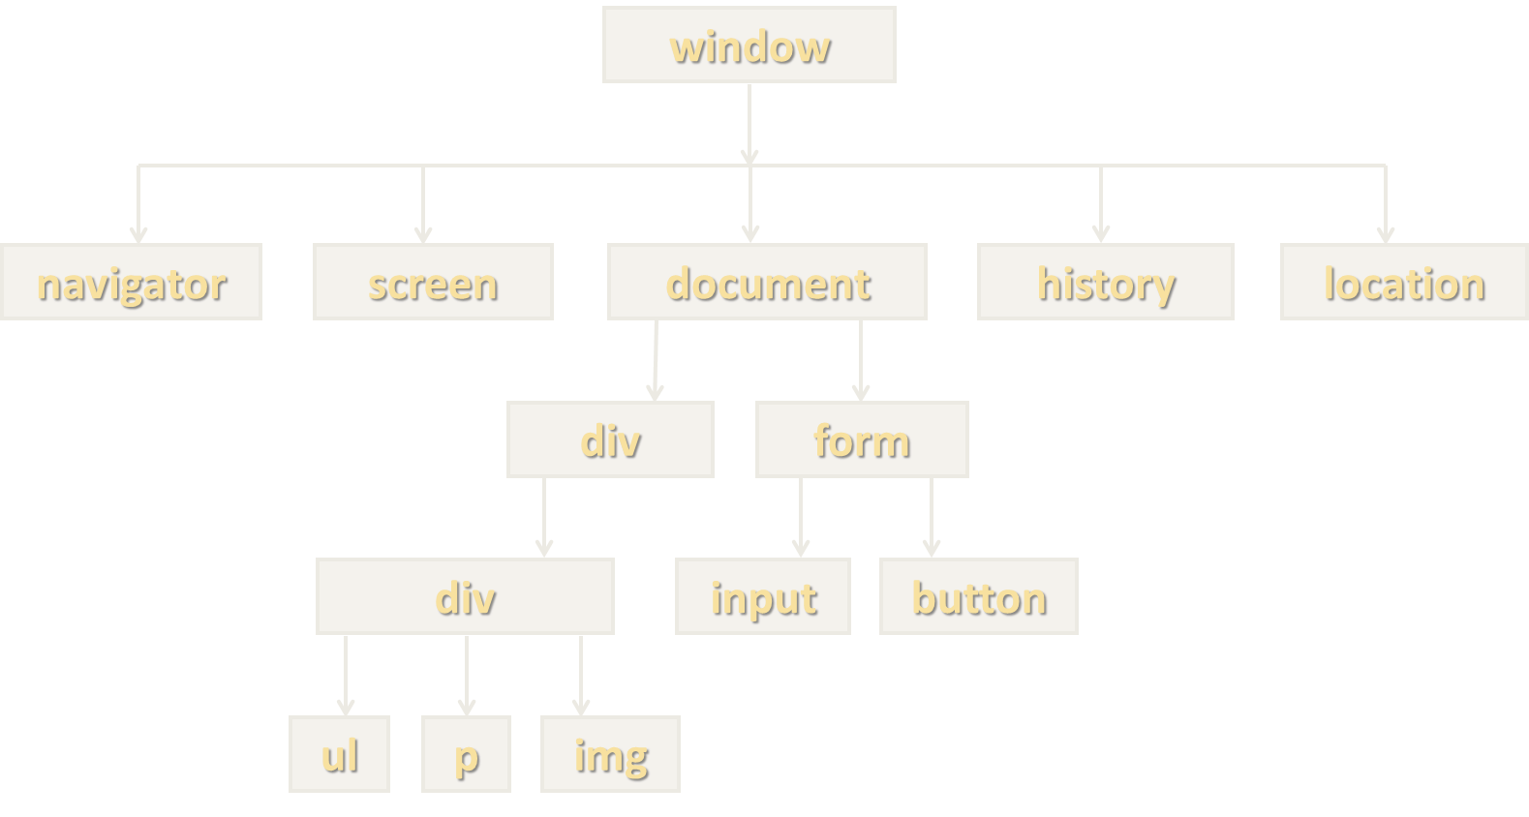
Browser Object Model (BOM)
Browsers provide expose some objects like window, screen, navigator, history, location, document, …
console.dir(window);
console.dir(navigator);
console.dir(screen);
console.dir(location);
console.dir(history);
console.dir(document);

Slide 28
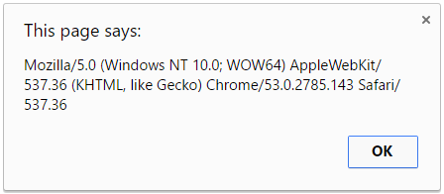
Playing with BOM
alert(window.navigator.userAgent);
console.log(navigator.language);
// en-US
console.log(screen.width + " x " + screen.height);
// 1920 x 1080
document.location = "https://softuni.bg";
history.back();

Slide 29

SetInterval() / ClearInterval()
In JS we can start / stop timers (intervals)
let intervalID = setInterval(
function() {
console.log("1 sec. passed");
},
1000
); // Delay = 1000 ms = 1 second
Remove (cancel) existing timer
clearInterval(intervalID); // Stop the timer

Slide 30
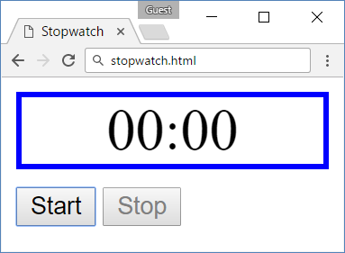
Problem: Stopwatch
A HTML page holds time-box + [Start] + [Stop] buttons
Implement the missing JS function stopwatch()
Increase the time at each second
Disable / enable buttons
<div id="time" style="border:3px solid blue; text-align:center; font-size:2em; margin-bottom:10px">00:00</div>
<button id="startBtn">Start</button>
<button id="stopBtn" disabled="true">Stop</button>
<script>window.onload = function() { stopwatch(); }</script>

Slide 31
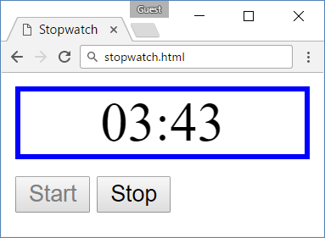
Solution: Stopwatch
function stopwatch() {
let time, intervalID;
let startBtn = document.getElementById('startBtn');
let stopBtn = document.getElementById('stopBtn');
startBtn.addEventListener('click', function() {
time = -1;
incrementTime();
intervalID = setInterval(
incrementTime, 1000);
startBtn.disabled = true;
stopBtn.disabled = false;
});

Slide 32
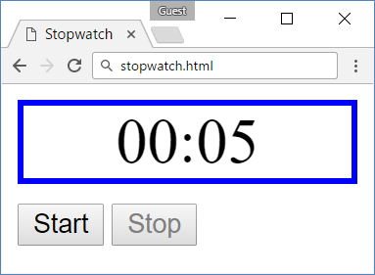
Solution: Stopwatch (2)
stopBtn.addEventListener(click, function() {
clearInterval(intervalID);
startBtn.disabled = false;
stopBtn.disabled = true;
});
function incrementTime() {
time++;
document.getElementById('time').textContent =
("0" + Math.trunc(time / 60)).slice(-2) +
':' + ("0" + (time % 60)).slice(-2);
}
}
Check your solution here: https://judge.softuni.bg/Contests/328

Slide 33
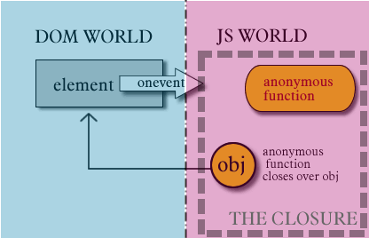
Handling Events
Browser Events and DOM Events

Slide 34
Handling Events in JS
Browsers send events to notify the JS code of interesting things that have taken place
<div id='text'>Some text</div>
let div = document.getElementById('text');
div.onmouseover = function(event) {
event.target.style.border = "3px solid green";
}
div.onmouseout = function() {
this.style.border = ""; // this === event.target
}

Slide 35
Event Types in DOM API
Mouse events
Touch events
DOM / UI events
click
mouseover mouseout mousedown
mouseup
touchstart
touchend
touchmove
touchcancel
load (finished loading)
unload (exit from page)
resize (window resized)
dragstart / drop
Keyboard events
Focus events
Form events
keydown
keypress (emit char)
keyup
focus (got focus)
blur (lost focus)
input (value changed)
change (change + leave) submit (form sent)
reset (form reset)
Learn more at https://developer.mozilla.org/docs/Web/Events

Slide 36
Add / Remove Event Handler
let textbox = document.createElement('input');
textbox.type = 'text';
textbox.value = "I am a text box";
document.body.appendChild(textbox);
textbox.addEventListener('focus', focusHandler);
function focusHandler(event) {
textbox.value = "Event handler removed";
textbox.removeEventListener('focus', focusHandler);
}
Subscribe to events like this, don't use onclick / onfocus

Slide 37
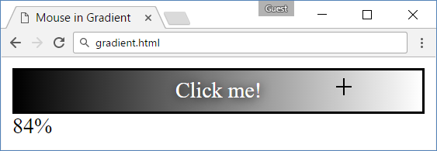
Problem: Mouse in Gradient
A HTML page holds linear gradient box
Clicking on it should show percentage [0% … 100%], depending on the place clicked
Left side → 0%; middle → 50%; right side → 100%

Slide 38
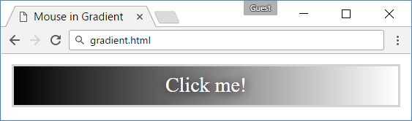
Problem: Mouse in Gradient – HTML
<html>
<head>
<title>Mouse in Gradient</title>
<link rel="stylesheet" href="gradient.css" />
<script src="gradient.js"></script>
</head>
<body onload="attachGradientEvents()">
<div id="gradient-box">
<div id="gradient">Click me!</div>
</div>
<div id="result"></div>
</body>
</html>

Slide 39
Problem: Mouse in Gradient – CSS
#gradient-box {
width: 300px;
border: 2px solid lightgrey;
}
#gradient-box:hover {
border: 2px solid black;
}
#gradient {
height: 30px;
color: white;
text-shadow:
1px 1px 10px black;
text-align: center;
line-height: 30px;
background:
linear-gradient(
to right, black, white);
cursor: crosshair;
}

Slide 40
Solution: Mouse in Gradient
function attachGradientEvents() {
let gradient = document.getElementById('gradient');
gradient.addEventListener('mousemove', gradientMove);
gradient.addEventListener('mouseout', gradientOut);
function gradientMove(event) {
let power = event.offsetX / (event.target.clientWidth - 1);
power = Math.trunc(power * 100);
document.getElementById('result').textContent = power + "%";
}
function gradientOut(event) {
document.getElementById('result').textContent = "";
}
};
Check your solution here: https://judge.softuni.bg/Contests/328

Slide 41

Practice: DOM and Events
Live Exercises in Class (Lab)

Slide 42


Summary
Browsers keep elements as DOM tree
Finding / modifying DOM elements:
Handling events:
let menu = document.getElementById('menu');
menu.style.display = 'none';
menu.appendChild(
document.createElement('hr'));
let menu = document.getElementById('menu');
menu.click = function(event) { … }

Slide 43









DOM, BOM and Events
https://softuni.bg/courses/javascript-advanced

Slide 44

License
This course (slides, examples, demos, videos, homework, etc.) is licensed under the "Creative Commons Attribution-NonCommercial-ShareAlike 4.0 International" license

Slide 45






Free Trainings @ Software University
Software University Foundation – softuni.org
Software University – High-Quality Education, Profession and Job for Software Developers
softuni.bg
Software University @ Facebook
facebook.com/SoftwareUniversity
Software University @ YouTube
youtube.com/SoftwareUniversity
Software University Forums – forum.softuni.bg

